Slide 1


Data Visualisation

Slide 2
Problem Statement :
There are many different scenarios where large amounts of data must be displayed to an audience, where they don’t get any insight with those csv files. So here comes the usage of data visualisation

Slide 3
Solution:
Data visualization allows this information to be displayed in an easy to read format that is both attractive and functional
It helps to convey information through visual representations

Slide 4
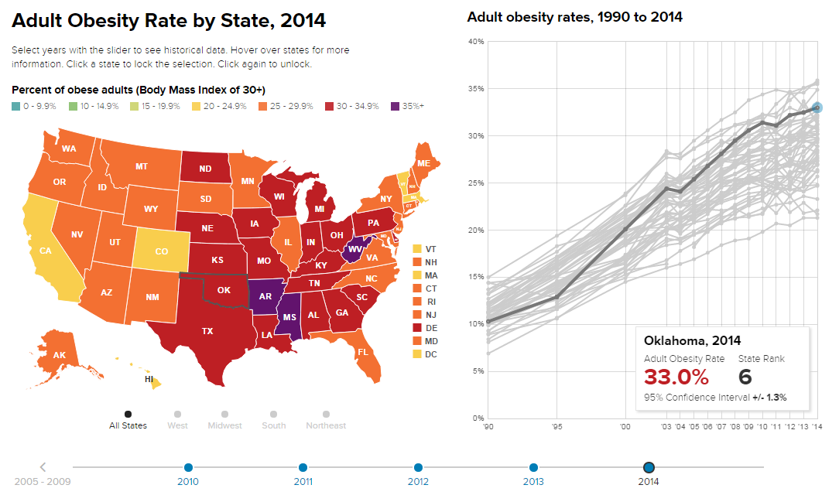
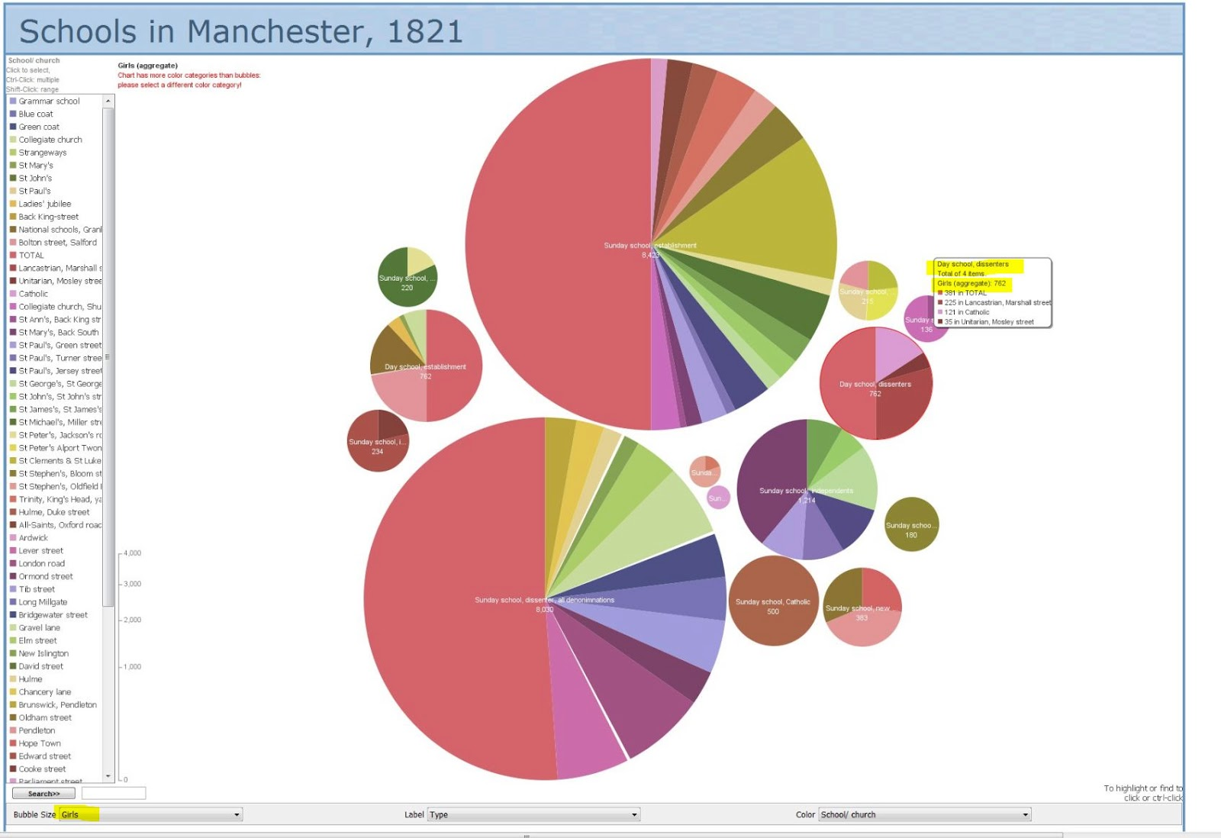
It produces interactive visual representations of abstract data to reinforce human cognition thus enabling the viewer to gain knowledge about the internal structure of the data

Slide 5
Code #

Slide 6
Thank You
TEAM: Hemasai
Akhileshwar reddy
Manoj varma
Radha Krishna
Jaswanth

